Slide 1
Bazaar
Donna-Frances SEI-Flex Immersive Cohort

Slide 2
Overview
Bazaar is an online marketplace that allows boutique and bespoke sellers to share their high-quality goods across the globe. Users are allowed to both be buyers and sellers. The selling is accomplished by users creating a virtual store which allows them to list their unique products and allow anyone across the globe to order them.

Slide 3
Team Etsy
Donna:
Hailey Sellars
Brendan Mohan
Jamie Boeing
Avary Mitchell
Frances:
Joezari Borlongan
Michael Terry
Nick Daly
Jacob Zagorenko

Slide 4
Key Features
Feature 1 - Seller Stores
Any user can create their own unique store within the site.
The store allows the user to list their unique items for sale to any user on the site.
Feature 2 - Search Bar
We implemented a search bar which allows us to search for specific products across the site.
Feature 3 - Image Uploading
Users can upload images of their product directly to their stores.
Users are also able to upload a profile image allowing for enhanced customization.

Slide 5
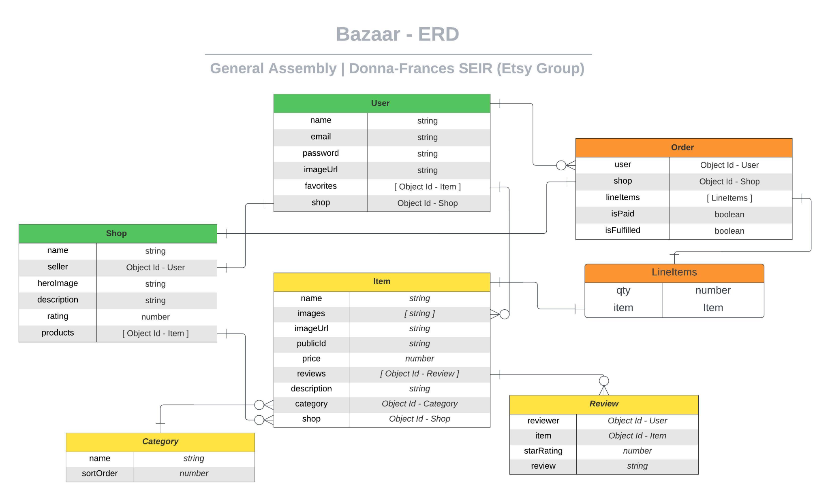
Models

Slide 6
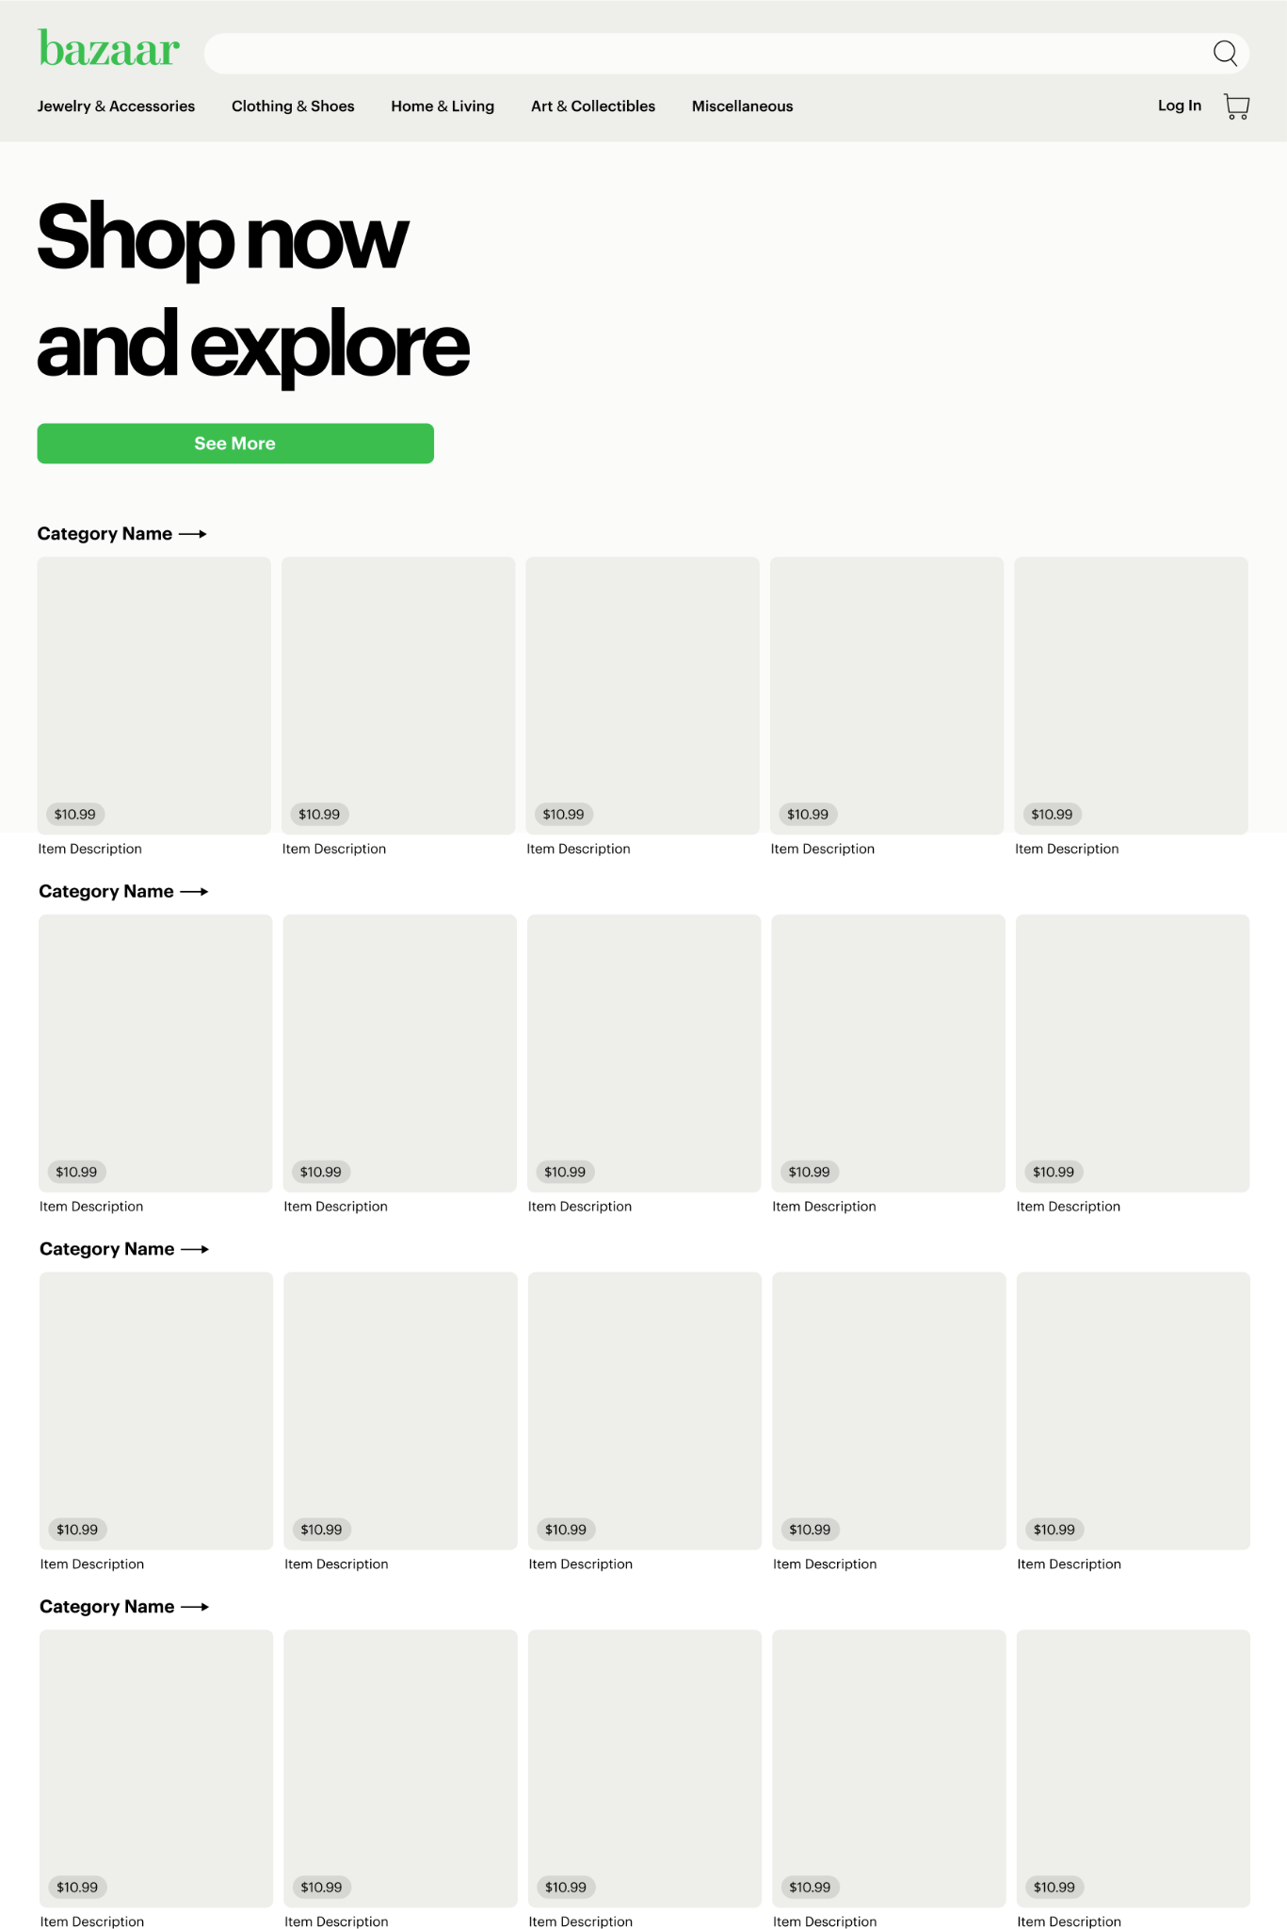
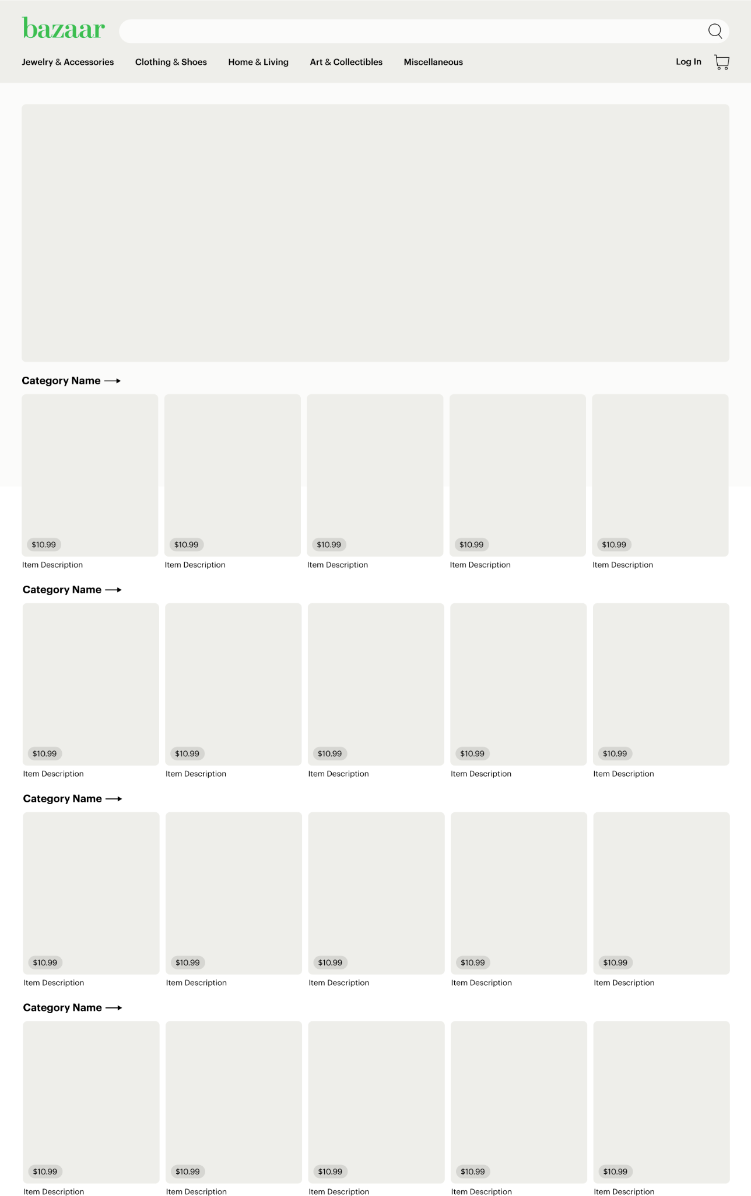
Wireframes
Home Page
Home Page - Hero Image

Slide 7
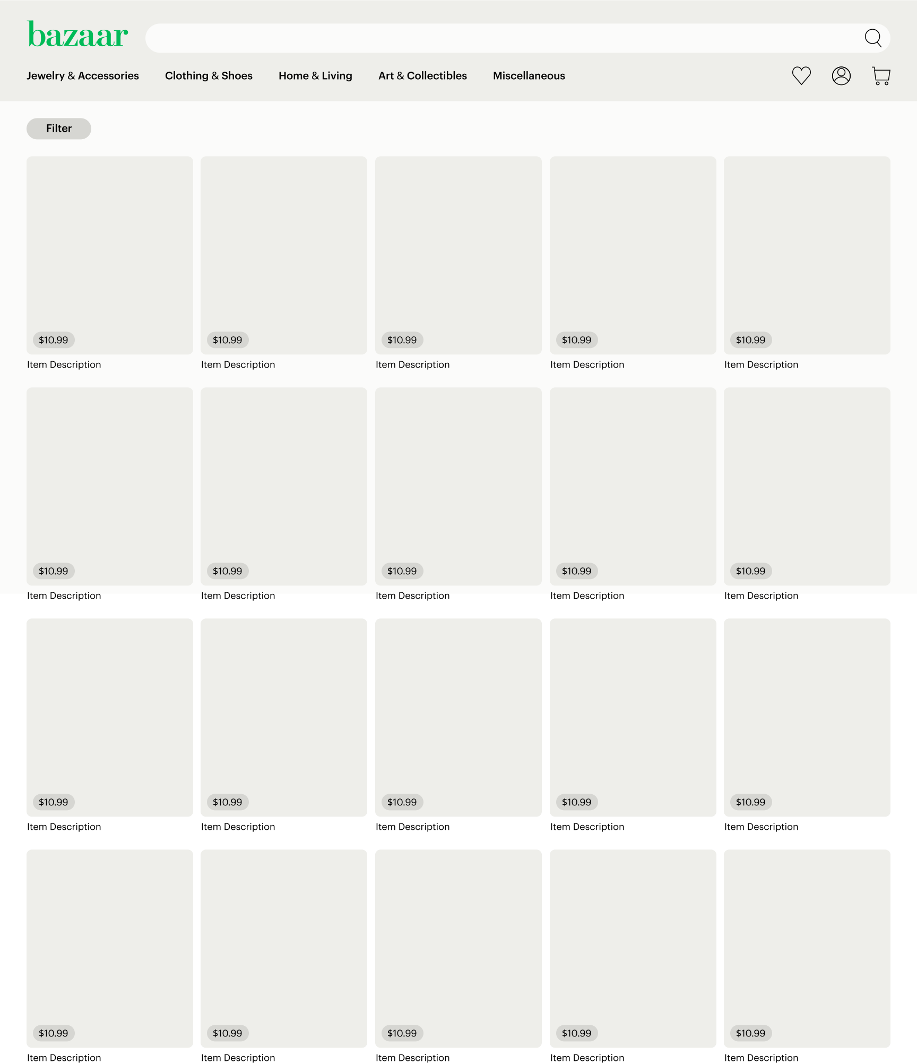
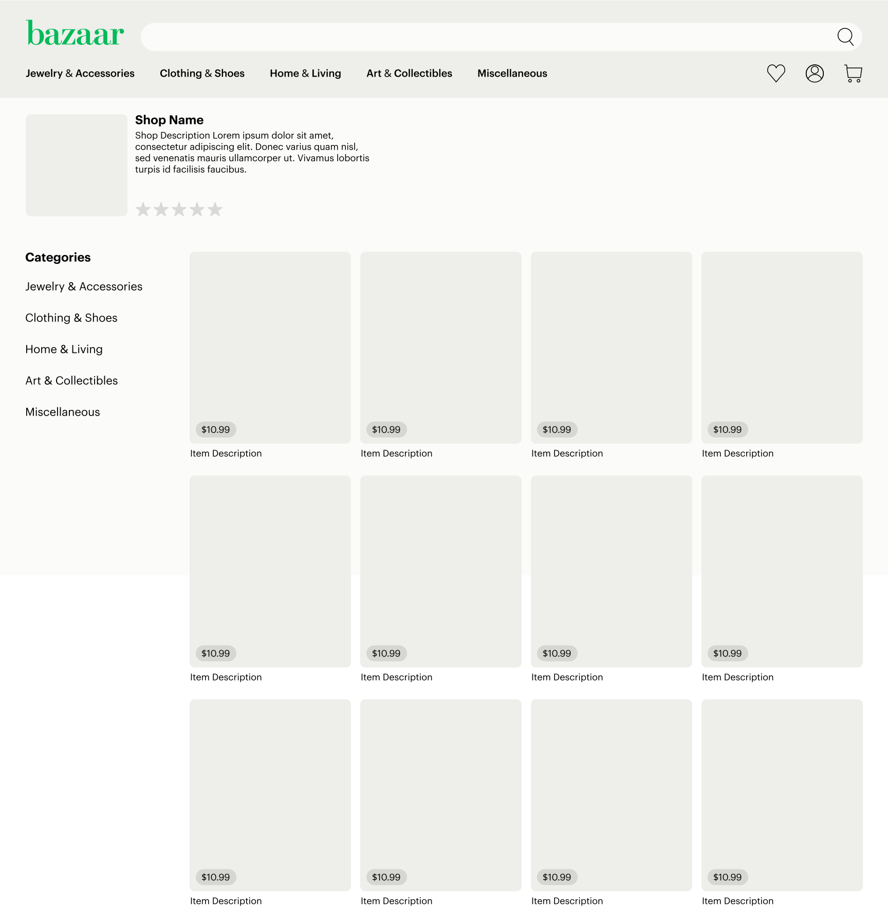
Wireframes
Shopping Page
Seller Shop Page

Slide 8
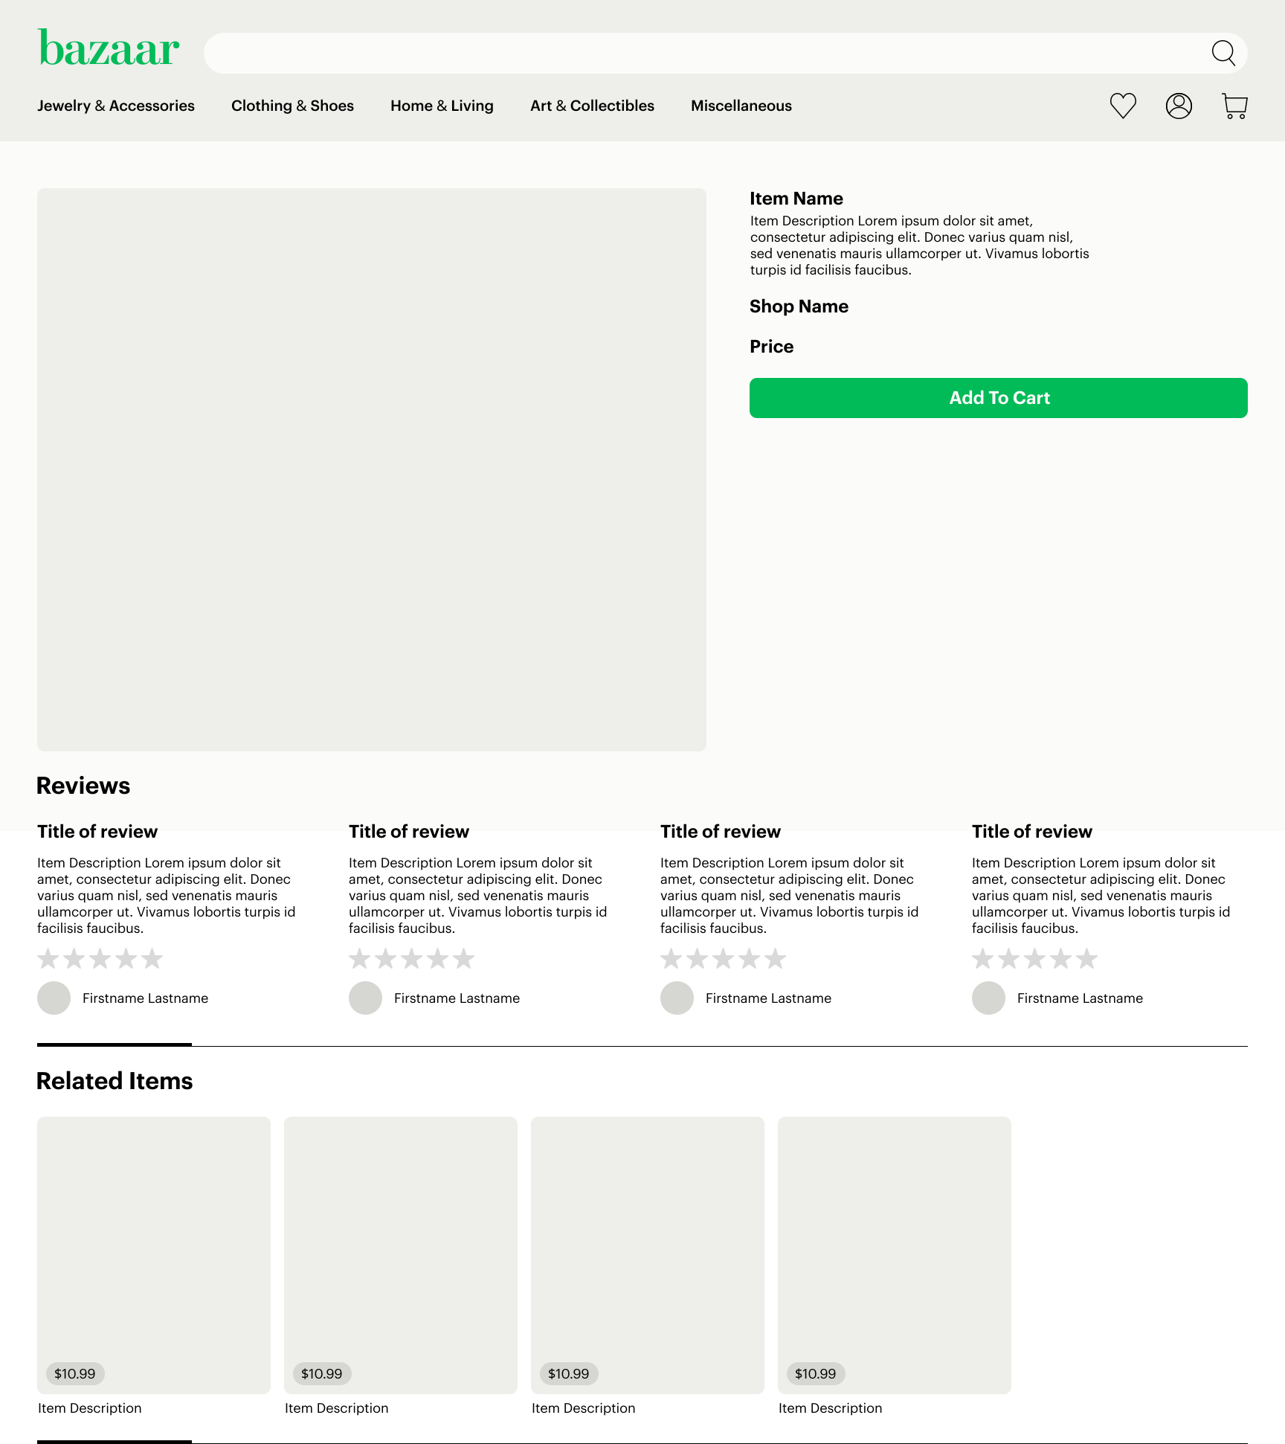
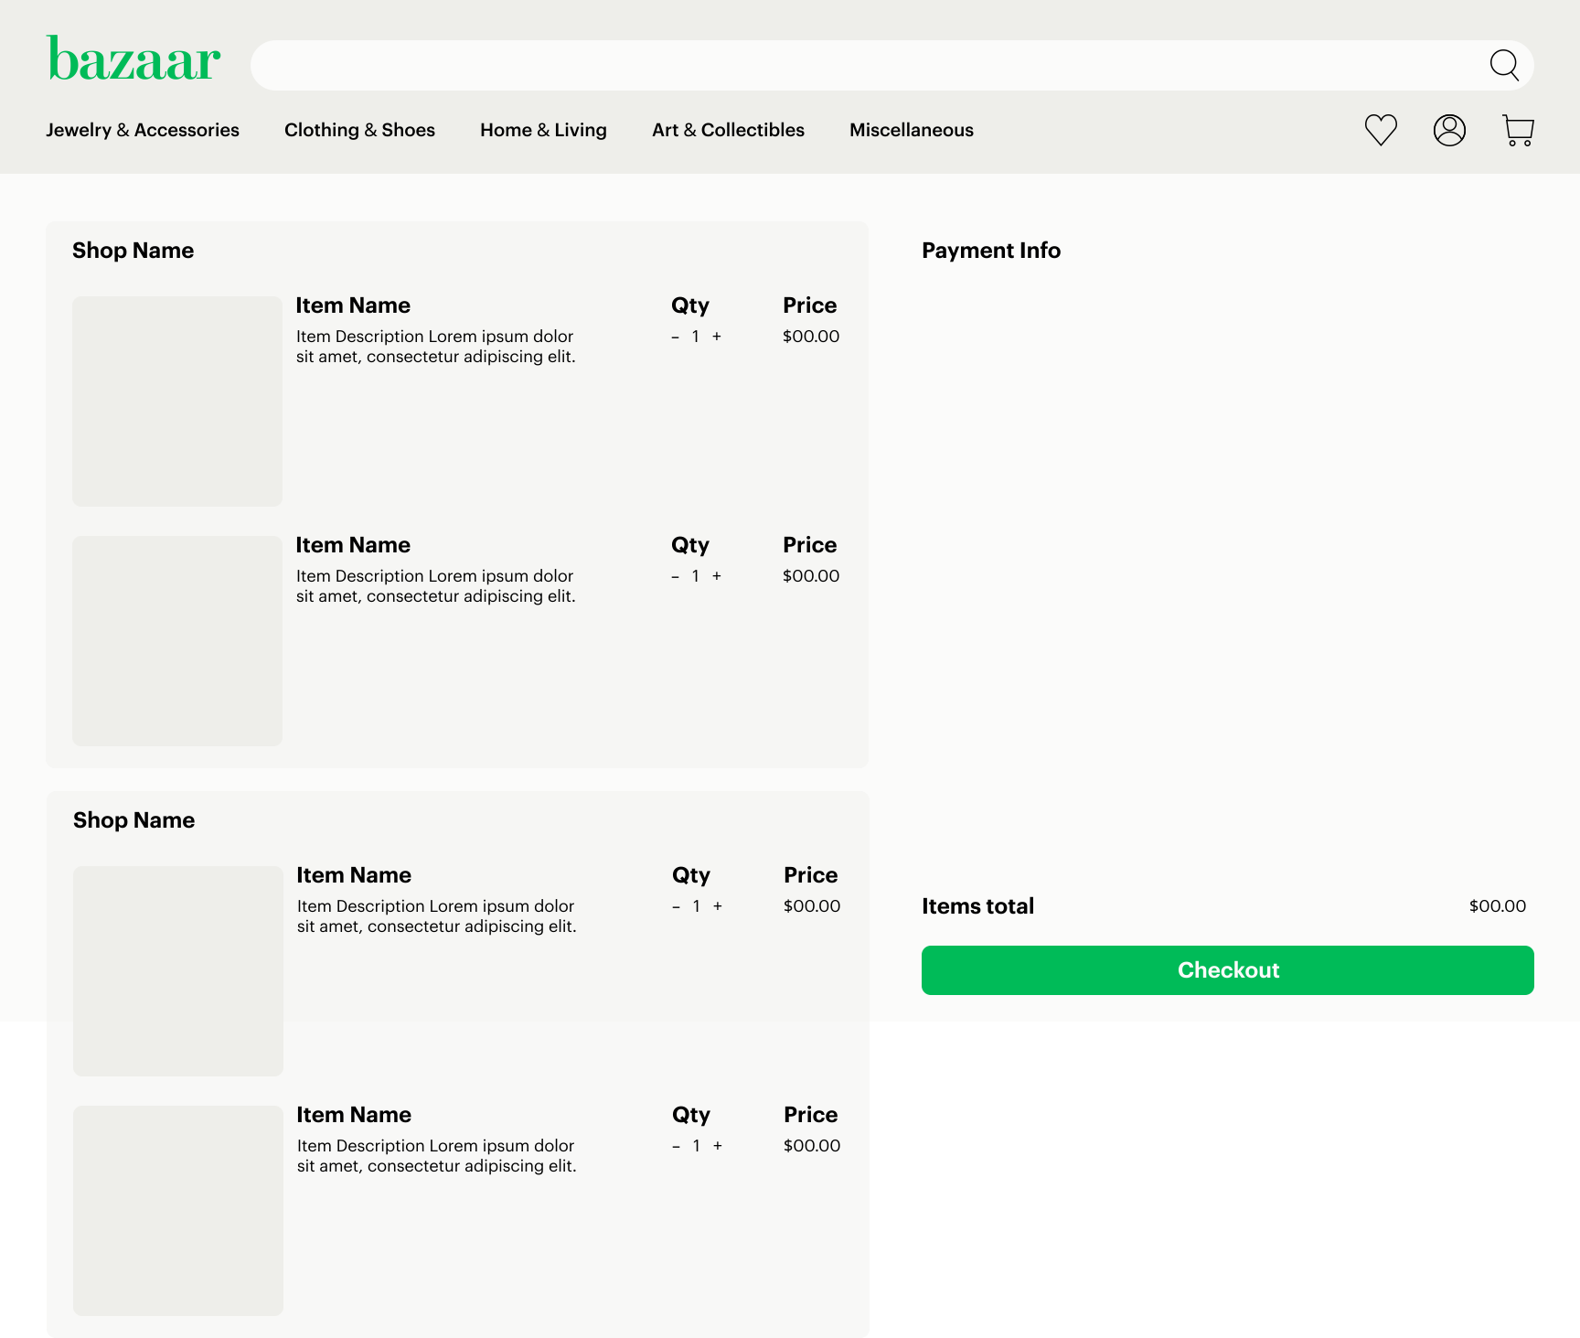
Wireframes
Item Detail Page
Cart Page

Slide 9
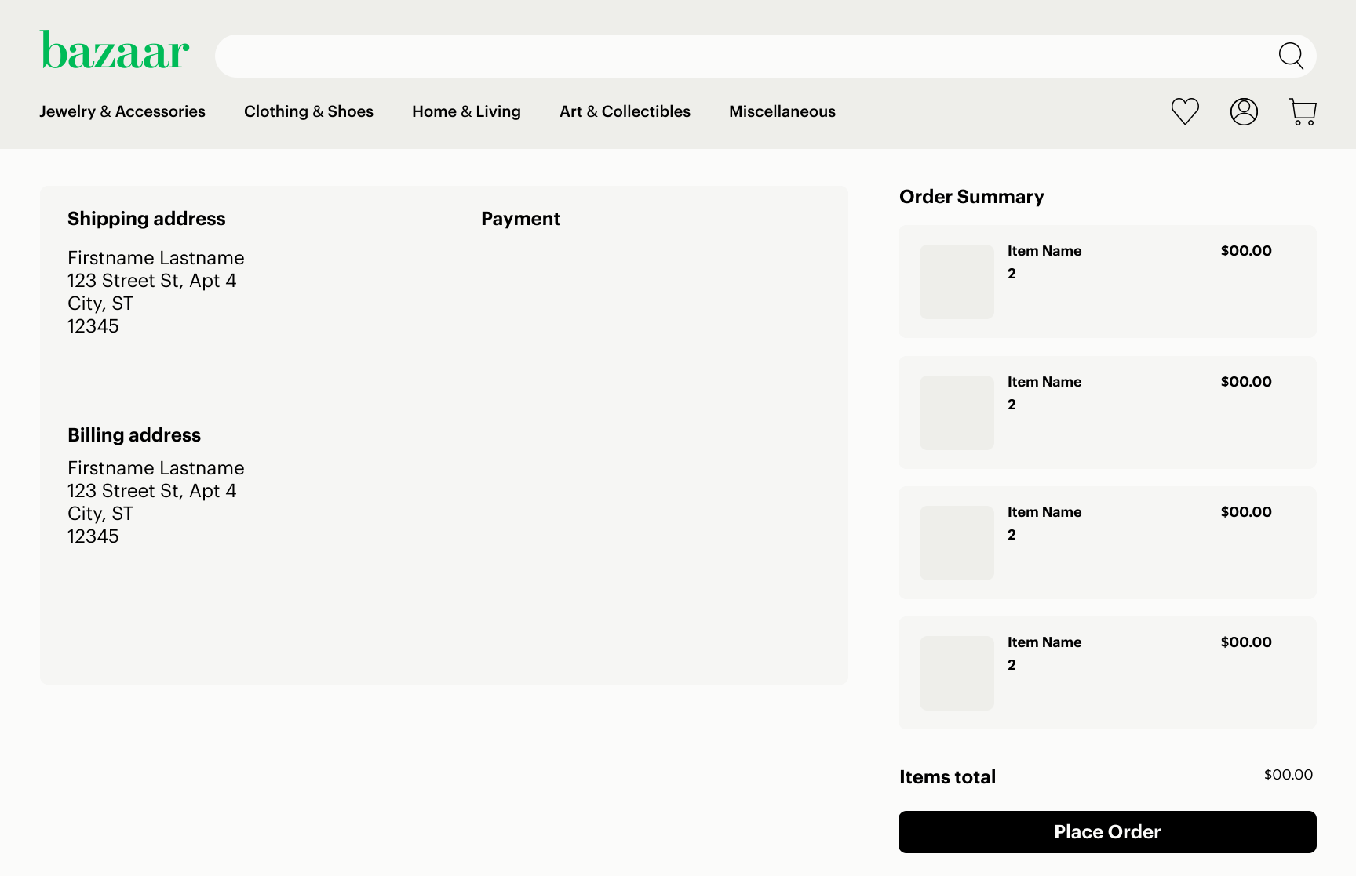
Wireframes
Checkout Page

Slide 10
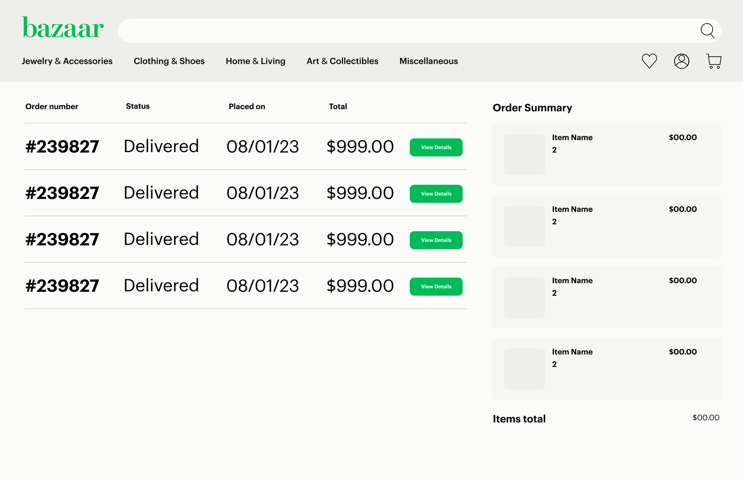
Wireframes
Order History Page

Slide 11
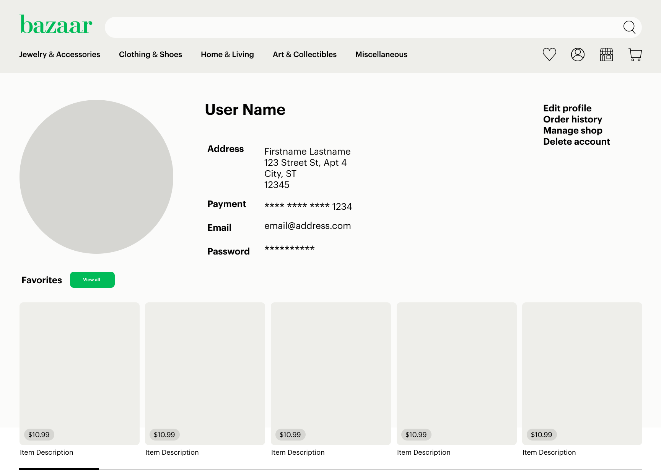
Wireframes
User Profile Page

Slide 12
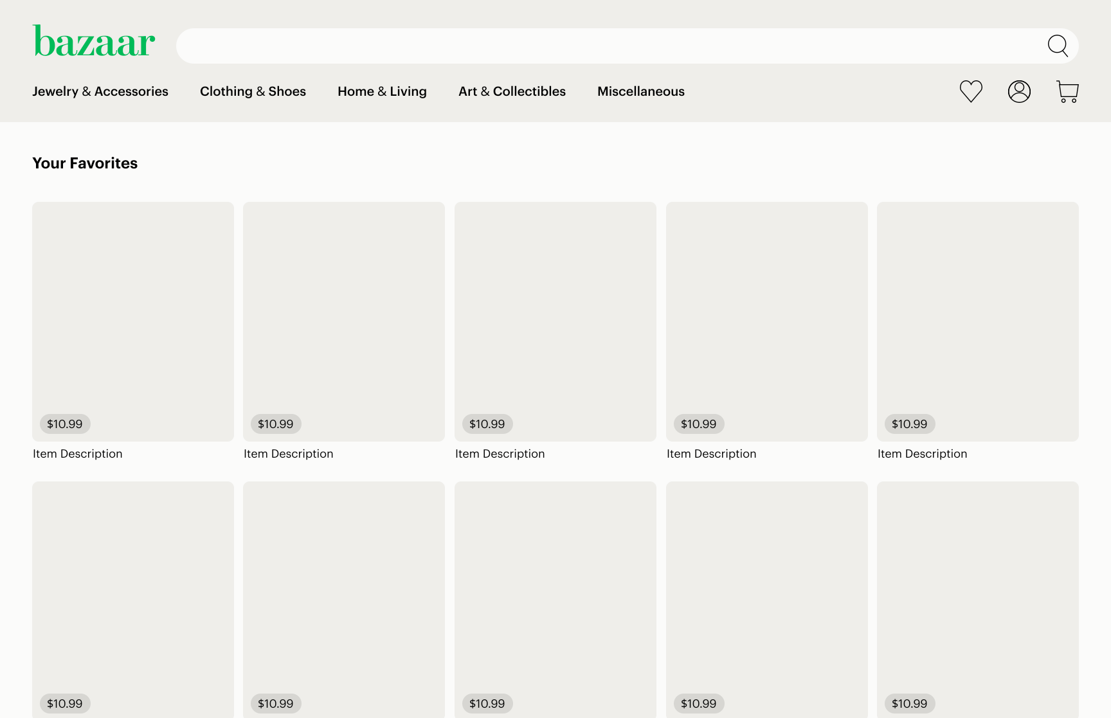
Wireframes
Favorites Page

Slide 13
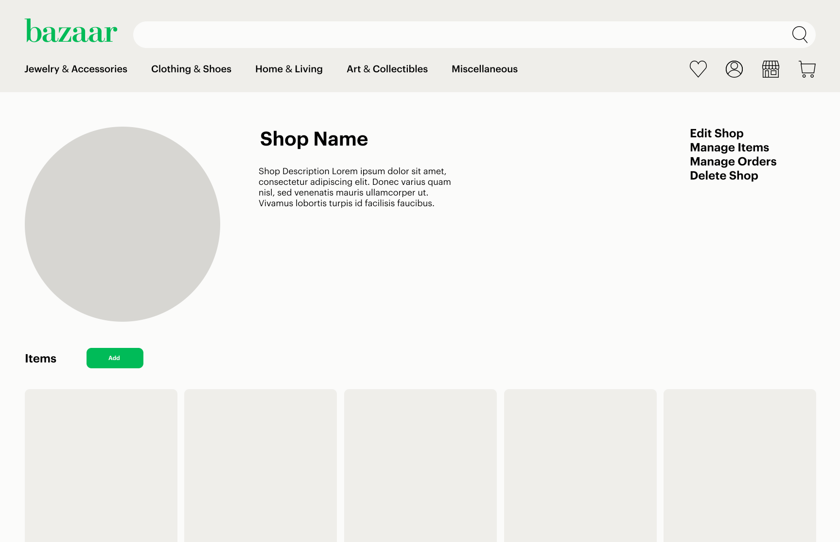
Wireframes
Shop Management Page

Slide 14
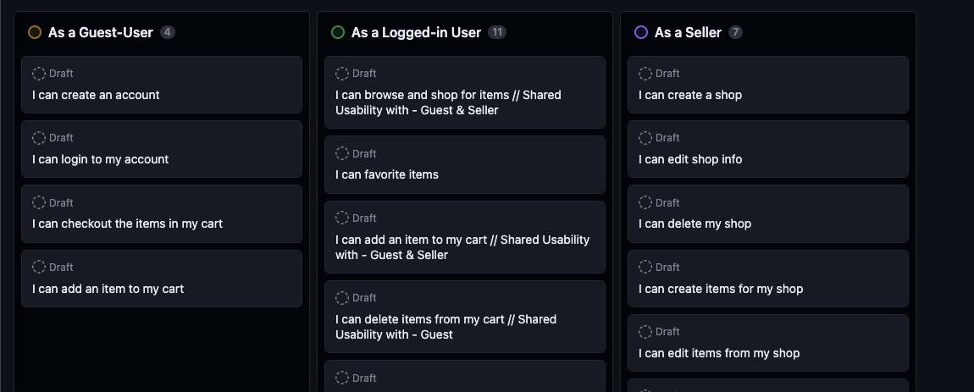
User Stories

Slide 15








Technologies Used

Slide 16
Live Link

Slide 17
Thank You!
Questions?

